Slide 1
Niels Bach Storgaard
Project 2.1 Web Documentary
Gabriela Rodickova | Kamelia Emilova Kalcheva | Ionut Andrei Sacaleanu | Lyudmil Lachev
21 Feb 2019

Slide 2
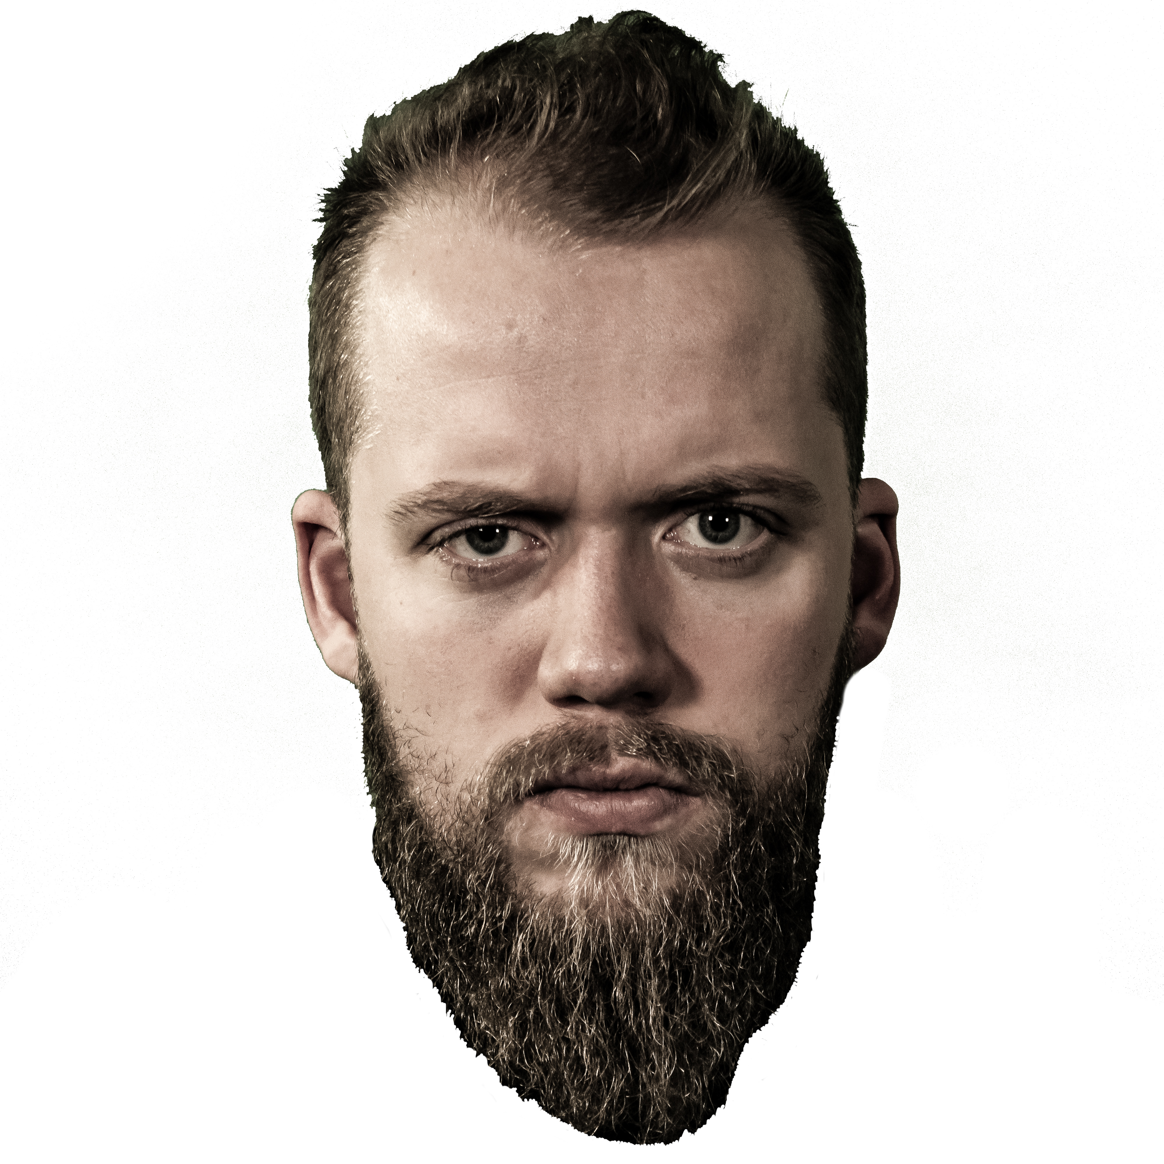
Jazzmetal – Team 8X
Niels Bach Storgaard

Slide 3
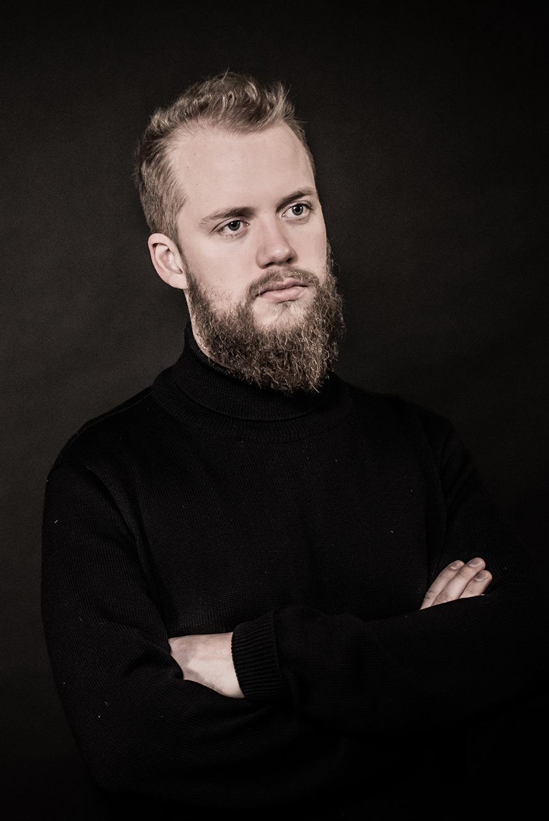
Problem statement
How can we attract more people and tell the story of our artist?
How can we present his work in a digital solution which is visually attractive?

Slide 4
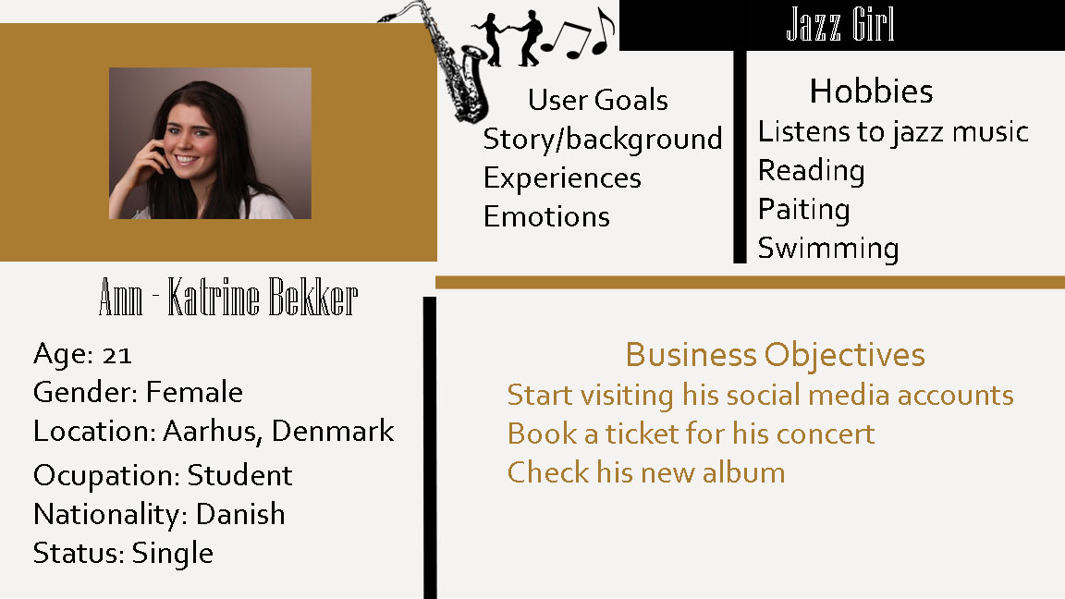
Target audience and personas

Slide 5
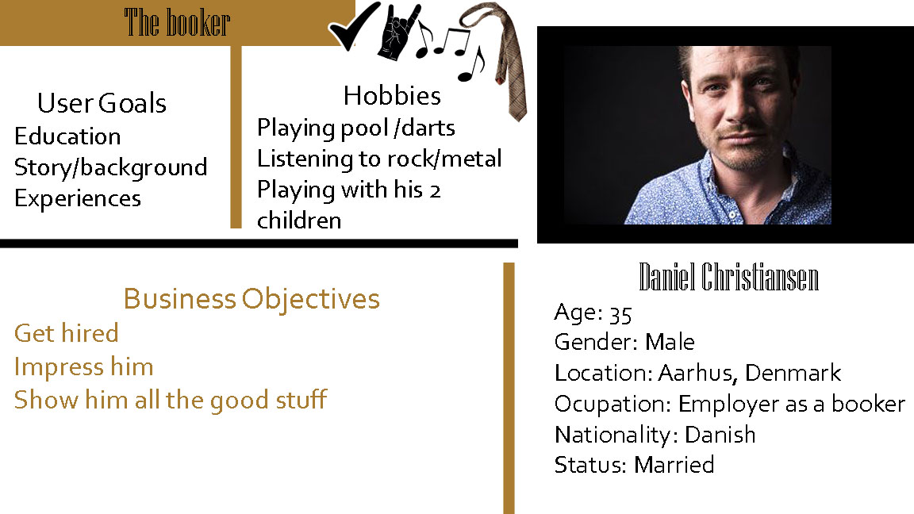
Target audience and personas

Slide 6
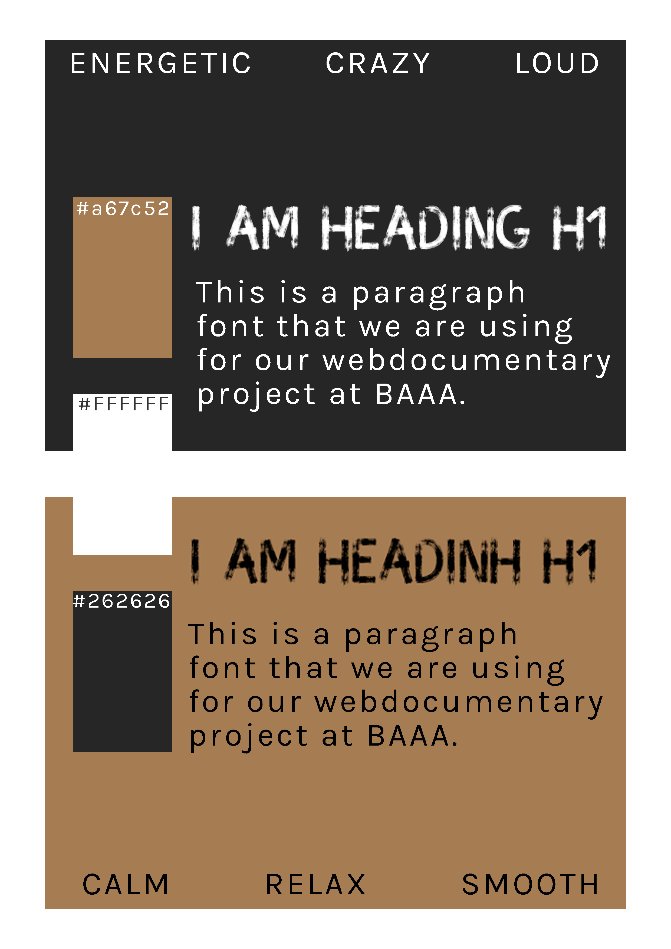
Design

Slide 7
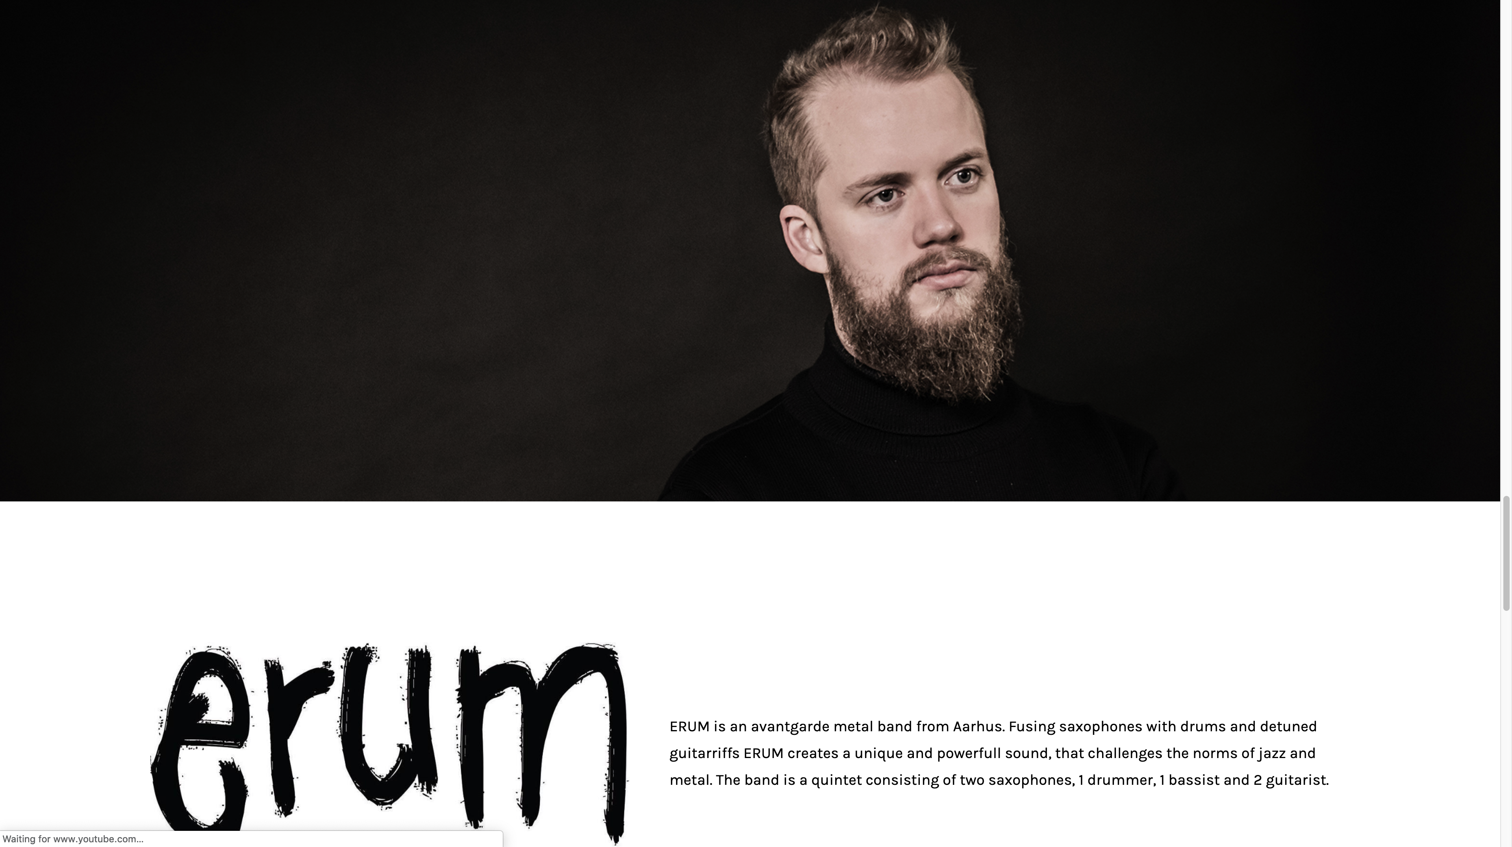
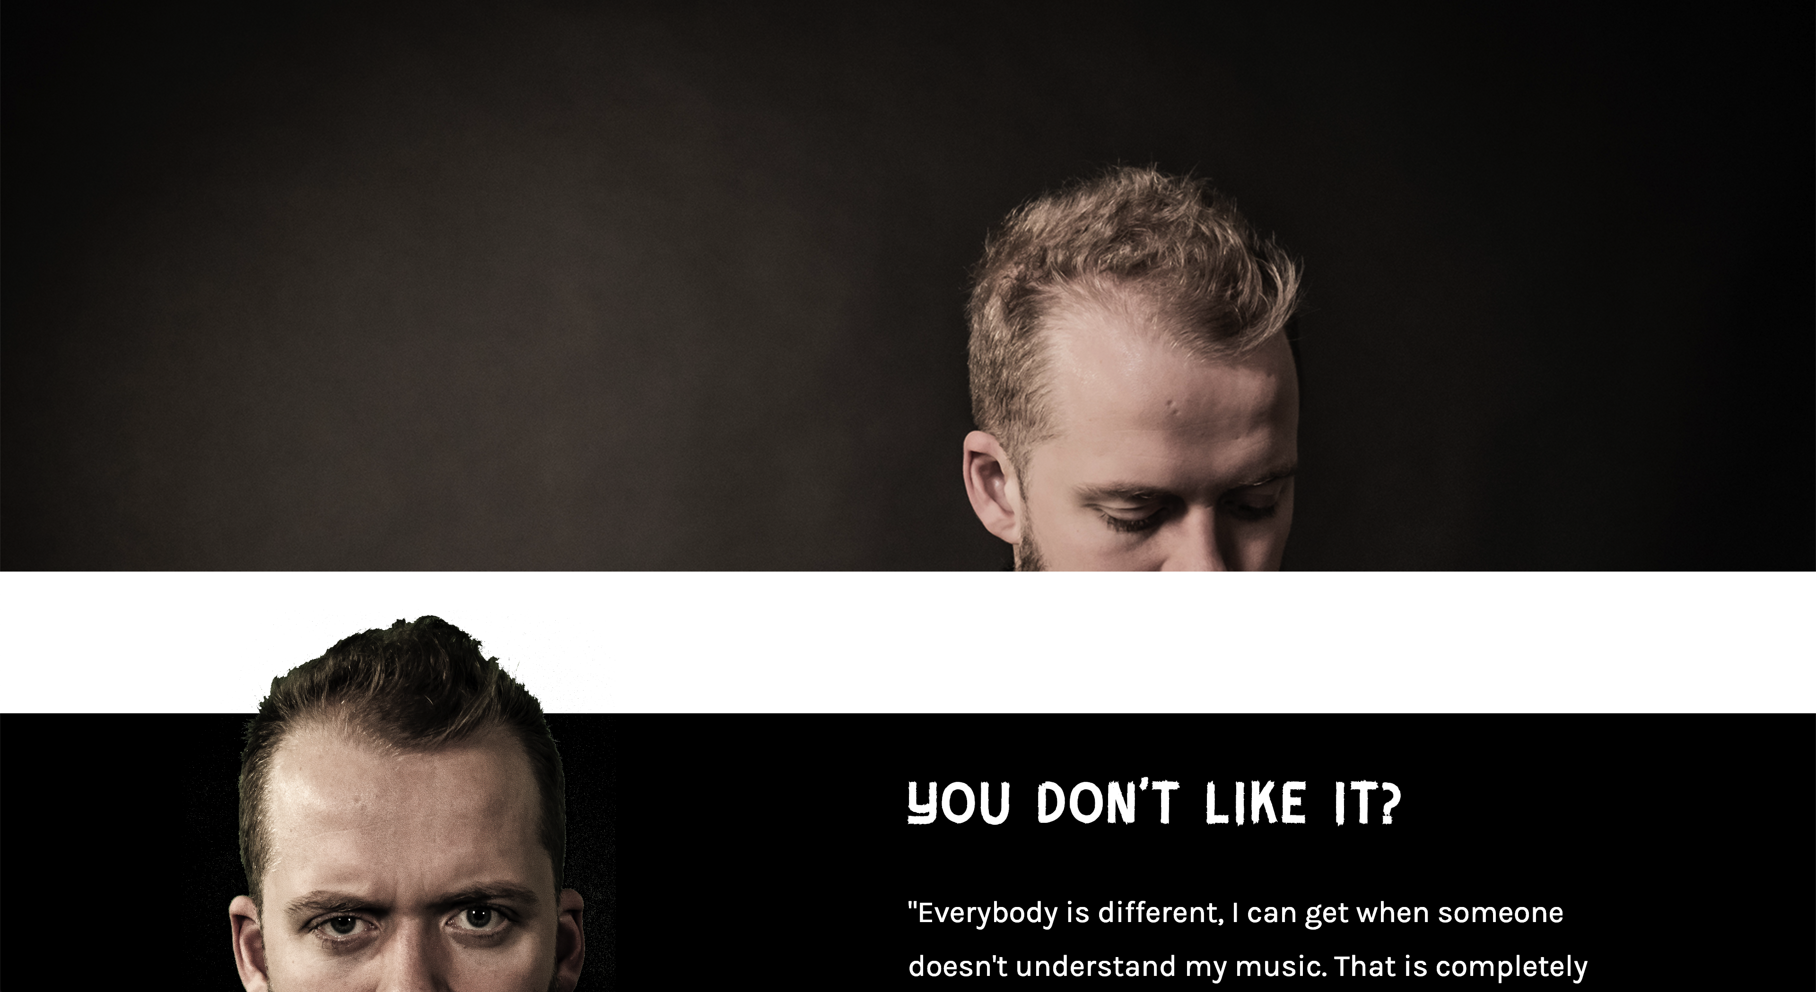
Our solution

Slide 8
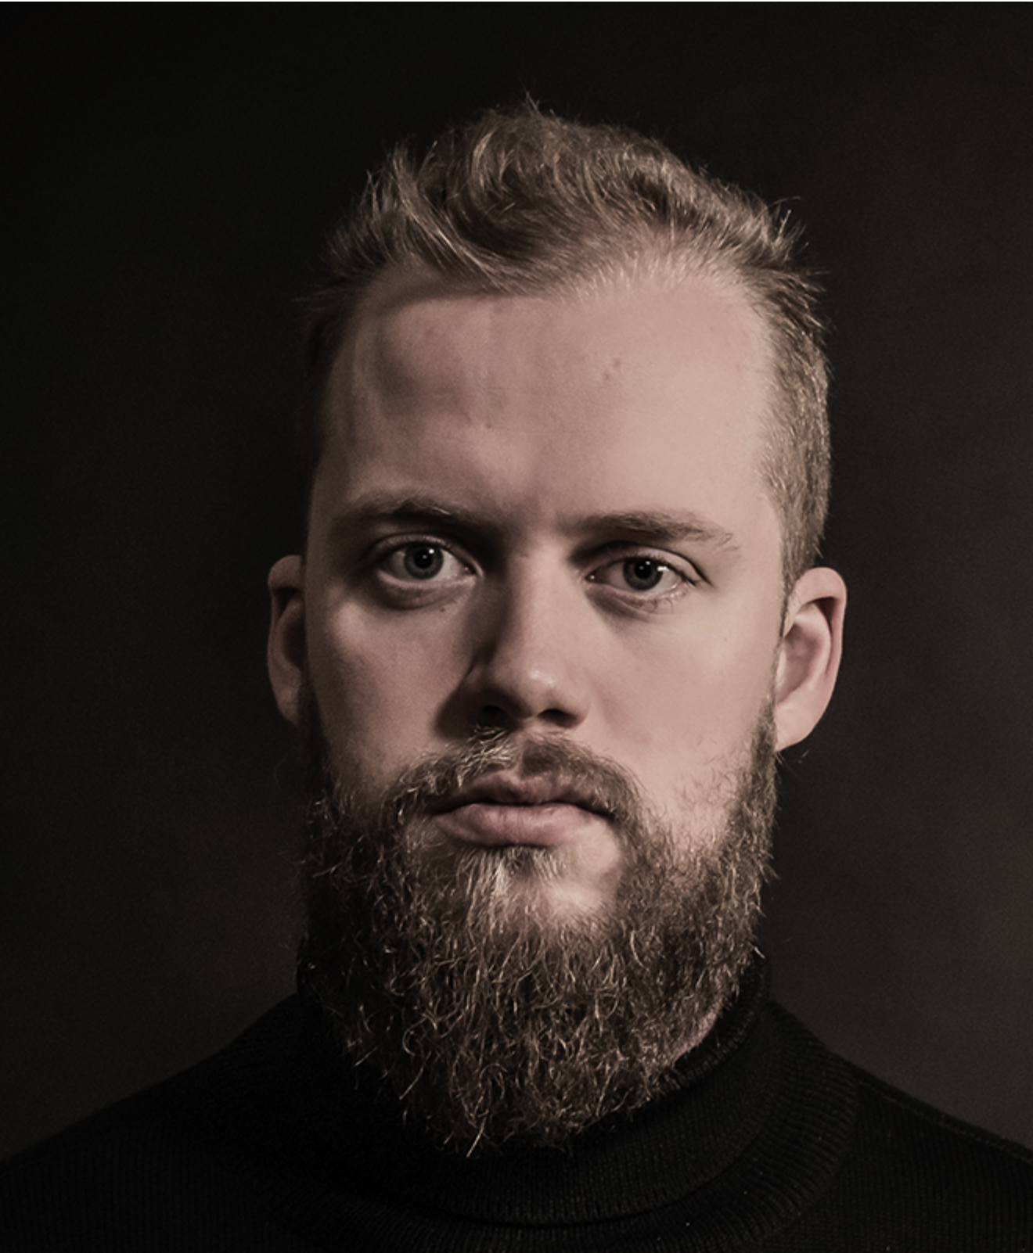
We made it?

Slide 9
Thank you!

